Slide 1
Wi-Fi Traffic Monitoring System

Slide 2
Wi-Fi Traffic Monitoring System
Notes:
- First chapter we learned different components of network ( nut and bolt of network )
- Second chapter we covered Network Protocol
- Third chapter we will cover a very important layer in network ( Network Layer ) from SDN point of view

Slide 3
Understand the fundamental principles of local WiFi network traffic
Learn a practical method for capturing and analyzing data packets
Explore how traffic monitoring can be used for performance analysis, security, and general network insights
Introduction
Lab setup
Simple dashboard and observation
Advance suggestions
Notes:
Hello, Anyohasye, Namaste
This is Prof Suman Pandey from EECS department GIST
We are learning Advanced Computer Networking
We are now in third modeul
Focusing on SDN archtesure
We learning about Generalized forwarding in prevous module
This module we focus on control plane

Slide 4
Introduction
Wi-Fi Traffic Monitoring
Notes:
- First chapter we learned different components of network ( nut and bolt of network )
- Second chapter we covered Network Protocol
- Third chapter we will cover a very important layer in network ( Network Layer ) from SDN point of view

Slide 5
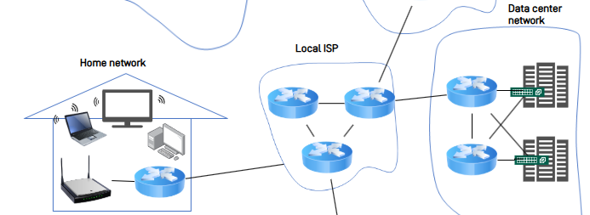
What is Wi-Fi Traffic and Why Monitor it?
What is Wi-Fi Traffic?
The flow of data packets between your devices and the router.
It's the invisible conversation happening on your network.
Why monitor it?
Security: Detect threats & unauthorized devices.
Performance: Find bottlenecks & manage bandwidth.
Troubleshooting: Diagnose connection issues.
source
Re-created illustration

Slide 6


The Central Role of the Router
The Router: Network’s Gateway
The router is the single gateway for all network traffic
All data packets must pass through it, making it the ideal monitoring point.
Our system uses a standard home/office router-no special hardware needed
Router

Slide 7


Core Concepts: How We Capture Traffic
Port Forwarding / Mirroring
A router feature that duplicates all traffic and sends a copy to our monitoring device.
Packet Sniffing
Software on our monitoring device (e.g. Wireshark) that captures and records the copied packets for analysis.
Internet
Router
Packet Capture

Slide 8
The Problem: Limitations of Commercial Routers
Closed Systems
Most commercial routers run vendor-specific OS, making it difficult to install custom software.
Solution: A Mini-PC as a Network “Checkpoint”
Use a Linux-based Mini-PC to act as a transparent router
It sits between your internet source and the existing Wi-Fi router, inspecting all incoming and outgoing traffic
Internet
Router
A Transparent Router Mini-PC

Slide 9
Summary
Why Monitor Traffic?
We monitor the flow of data packets on a network to enhance security, improve performance, and troubleshoot issues.
Our Approach
Since commercial routers are closed systems, we use a Mini-PC as a transparent router to intercept and analyze all traffic
Method
This setup allows us to duplicate (Mirroring) and capture (Sniffing) packets for detailed analysis.

Slide 10
Lab Setup
Notes:
- First chapter we learned different components of network ( nut and bolt of network )
- Second chapter we covered Network Protocol
- Third chapter we will cover a very important layer in network ( Network Layer ) from SDN point of view

Slide 11
Prerequisites
Docker
source
Re-created illustration

Slide 12
Activate virtual environment
source
Re-created illustration

Slide 13
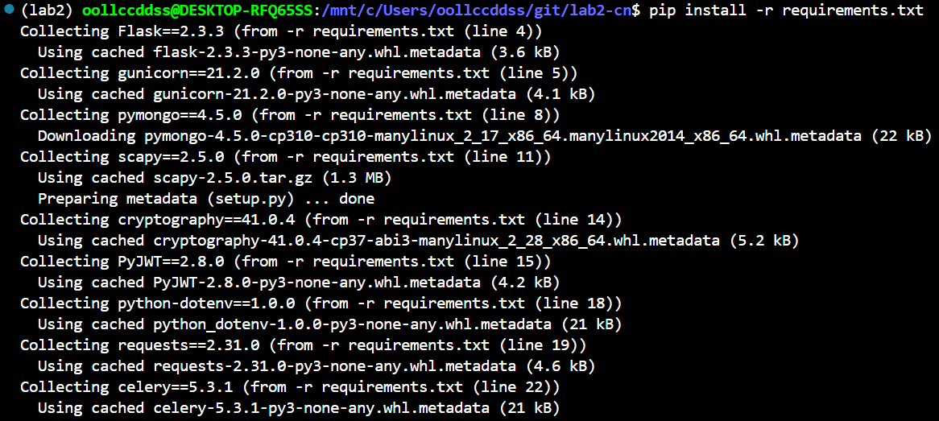
Install required packages
What is Wi-Fi Traffic?
The flow of data packets between your devices and the router.
It's the invisible conversation happening on your network.
Why monitor it?
Security: Detect threats & unauthorized devices.
Performance: Find bottlenecks & manage bandwidth.
Troubleshooting: Diagnose connection issues.
source
Re-created illustration

Slide 14
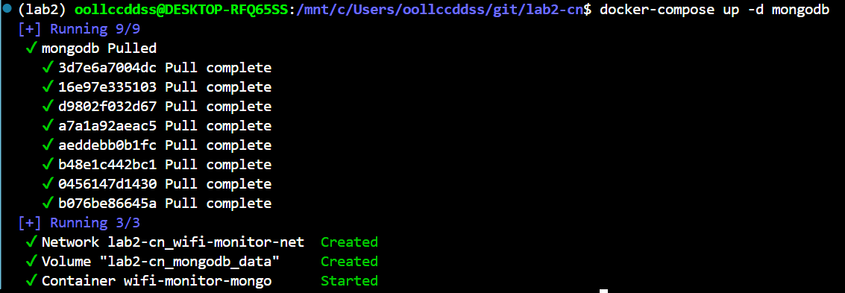
Docker compose test
What is Wi-Fi Traffic?
The flow of data packets between your devices and the router.
It's the invisible conversation happening on your network.
Why monitor it?
Security: Detect threats & unauthorized devices.
Performance: Find bottlenecks & manage bandwidth.
Troubleshooting: Diagnose connection issues.
source
Re-created illustration

Slide 15
Docker running test
What is Wi-Fi Traffic?
The flow of data packets between your devices and the router.
It's the invisible conversation happening on your network.
Why monitor it?
Security: Detect threats & unauthorized devices.
Performance: Find bottlenecks & manage bandwidth.
Troubleshooting: Diagnose connection issues.
source
Re-created illustration

Slide 16
MongoDB connection test
What is Wi-Fi Traffic?
The flow of data packets between your devices and the router.
It's the invisible conversation happening on your network.
Why monitor it?
Security: Detect threats & unauthorized devices.
Performance: Find bottlenecks & manage bandwidth.
Troubleshooting: Diagnose connection issues.
source
Re-created illustration

Slide 17
Prerequisites
What is Wi-Fi Traffic?
The flow of data packets between your devices and the router.
It's the invisible conversation happening on your network.
Why monitor it?
Security: Detect threats & unauthorized devices.
Performance: Find bottlenecks & manage bandwidth.
Troubleshooting: Diagnose connection issues.
source
Re-created illustration

Slide 18
Prerequisites
What is Wi-Fi Traffic?
The flow of data packets between your devices and the router.
It's the invisible conversation happening on your network.
Why monitor it?
Security: Detect threats & unauthorized devices.
Performance: Find bottlenecks & manage bandwidth.
Troubleshooting: Diagnose connection issues.
source
Re-created illustration

Slide 19
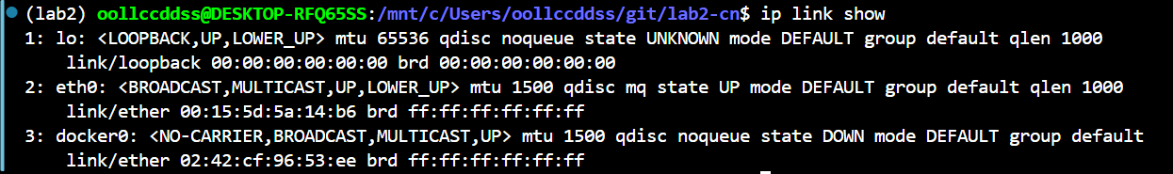
Prerequisites
What is Wi-Fi Traffic?
The flow of data packets between your devices and the router.
It's the invisible conversation happening on your network.
Why monitor it?
Security: Detect threats & unauthorized devices.
Performance: Find bottlenecks & manage bandwidth.
Troubleshooting: Diagnose connection issues.
source
Re-created illustration

Slide 20
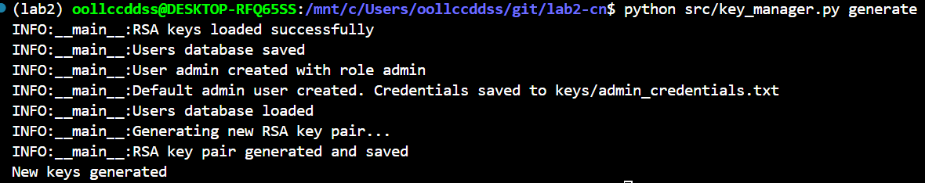
Prerequisites
What is Wi-Fi Traffic?
The flow of data packets between your devices and the router.
It's the invisible conversation happening on your network.
Why monitor it?
Security: Detect threats & unauthorized devices.
Performance: Find bottlenecks & manage bandwidth.
Troubleshooting: Diagnose connection issues.
source
Re-created illustration

Slide 21
Prerequisites
What is Wi-Fi Traffic?
The flow of data packets between your devices and the router.
It's the invisible conversation happening on your network.
Why monitor it?
Security: Detect threats & unauthorized devices.
Performance: Find bottlenecks & manage bandwidth.
Troubleshooting: Diagnose connection issues.
source
Re-created illustration

Slide 22
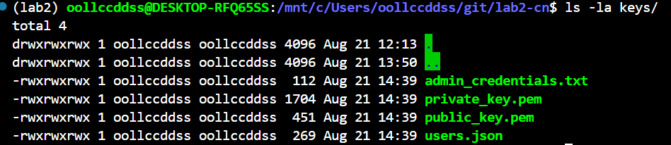
Prerequisites
What is Wi-Fi Traffic?
The flow of data packets between your devices and the router.
It's the invisible conversation happening on your network.
Why monitor it?
Security: Detect threats & unauthorized devices.
Performance: Find bottlenecks & manage bandwidth.
Troubleshooting: Diagnose connection issues.
source
Re-created illustration

Slide 23
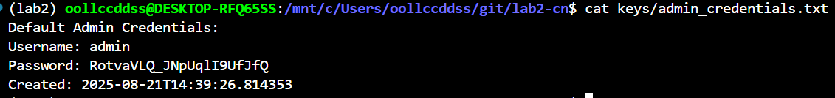
Prerequisites
What is Wi-Fi Traffic?
The flow of data packets between your devices and the router.
It's the invisible conversation happening on your network.
Why monitor it?
Security: Detect threats & unauthorized devices.
Performance: Find bottlenecks & manage bandwidth.
Troubleshooting: Diagnose connection issues.
source
Re-created illustration

Slide 24
Simple Dashboard and Observation
Notes:
- First chapter we learned different components of network ( nut and bolt of network )
- Second chapter we covered Network Protocol
- Third chapter we will cover a very important layer in network ( Network Layer ) from SDN point of view

Slide 25

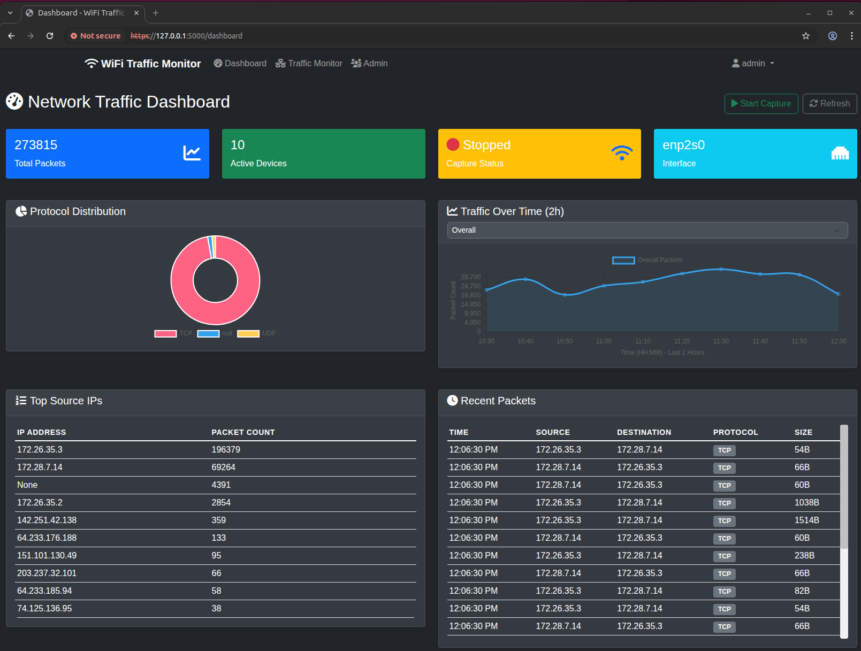
Dashboard Overview: Visualizing Network Traffic
Start Button for
Packet Capturing
Menu
Main Contents of Dashboard

Slide 26
Three Key Features: A Quick Tour
Dashboard
A visual summary page to understand the network’s overall status and traffic patterns at a glance through graphs and charts.
Traffic Monitor
A detailed investigation tool to troubleshoot network issues by searching and analyzing specific packets with filtering.
Admin Panel
An admin-only page to control user access and manage the system’s overall status and security.

Slide 27
Simple Dashboard and Observation
- Dashboard -
Notes:
- First chapter we learned different components of network ( nut and bolt of network )
- Second chapter we covered Network Protocol
- Third chapter we will cover a very important layer in network ( Network Layer ) from SDN point of view

Slide 28
A Snapshot of Network’s Health
The top panel offers a real-time summary of the network’s critical information
Total Packets
The cumulative count of all captured packets.
Active Devices
Shows the number of unique devices currently sending or receiving data.
Capture Status & Interface
Clearly indicates if the monitoring system is currently running (Status) and which network card (interface) is being monitored.

Slide 29
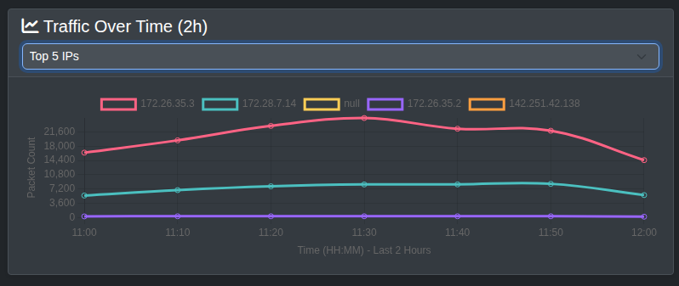
Traffic Patterns: What Kind and When?
Protocol Distribution
This donut chart shows the proportion of different protocols, like TCP and UDP.
It helps you understand the primary purpose of the network’s usage, whether it’s for web browsing (TCP) or for video streaming and gaming (UDP).
Traffic Over Time
This line graph displays the trend of traffic volume over a specific period.
It’s essential for identifying the network’s busiest periods and spotting anomalies, such as sudden and unexpected traffic spikes.

Slide 30
Detailed Analysis: Who is Talking and What Are They Saying?
Top Source Ips
This table ranks the IP addresses that have generated the most packets on the network.
It allows you to identify which devices are consuming the most bandwidth.
Recent Packets
A real-time log of captured packets, displayed chronologically with details like source, destination, protocol, and size.
This provides the most granular and specific data.

Slide 31
Simple Dashboard and Observation
- Traffic Monitor -
Notes:
- First chapter we learned different components of network ( nut and bolt of network )
- Second chapter we covered Network Protocol
- Third chapter we will cover a very important layer in network ( Network Layer ) from SDN point of view

Slide 32
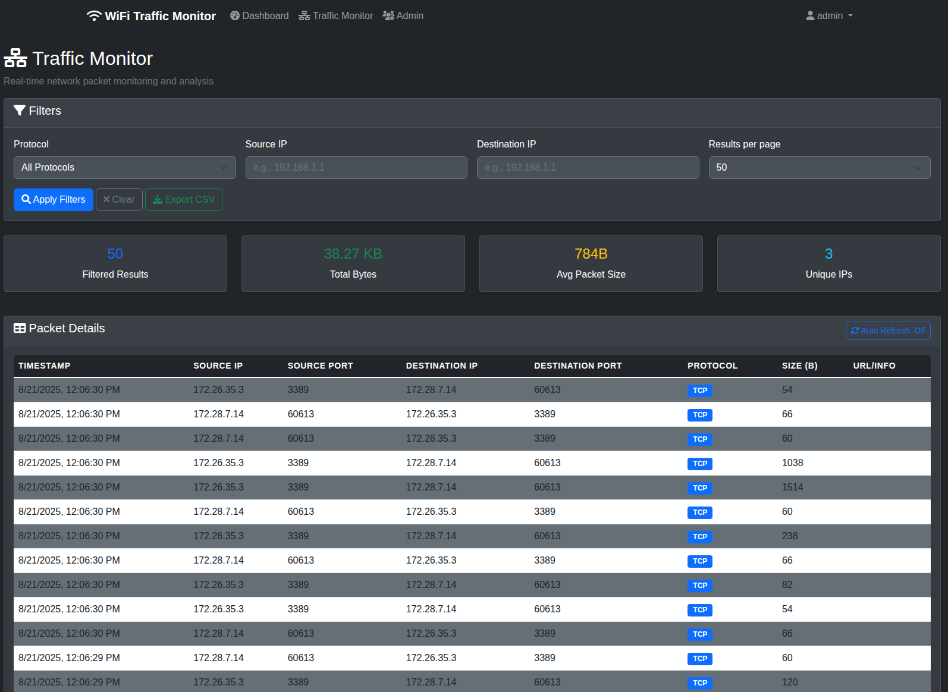
Traffic Monitor: Deep Packet Inspection
The Traffic Monitor page is an interactive tool for detailed, real-time analysis of captured packets.
Unlike the main dashboard which provides a summary, this view allows you to filter, search, and drill down into specific network conversations for in-depth investigation and troubleshooting.

Slide 33
Traffic Monitor: Deep Packet Inspection
Filters:
Allows you to pinpoint specific data flows.
You can search by Protocol, Source IP, and Destination IP.
Exporting:
Enables offline analysis and reporting.
The “Export CSV” feature allows you to save your filtered results, making it easy to share data or perform further analysis in other tools like Excel.

Slide 34
Simple Dashboard and Observation
- Admin Panel -
Notes:
- First chapter we learned different components of network ( nut and bolt of network )
- Second chapter we covered Network Protocol
- Third chapter we will cover a very important layer in network ( Network Layer ) from SDN point of view

Slide 35
Traffic Monitor: Deep Packet Inspection
The Traffic Monitor page is an interactive tool for detailed, real-time analysis of captured packets.
Unlike the main dashboard which provides a summary, this view allows you to filter, search, and drill down into specific network conversations for in-depth investigation and troubleshooting.

Slide 36
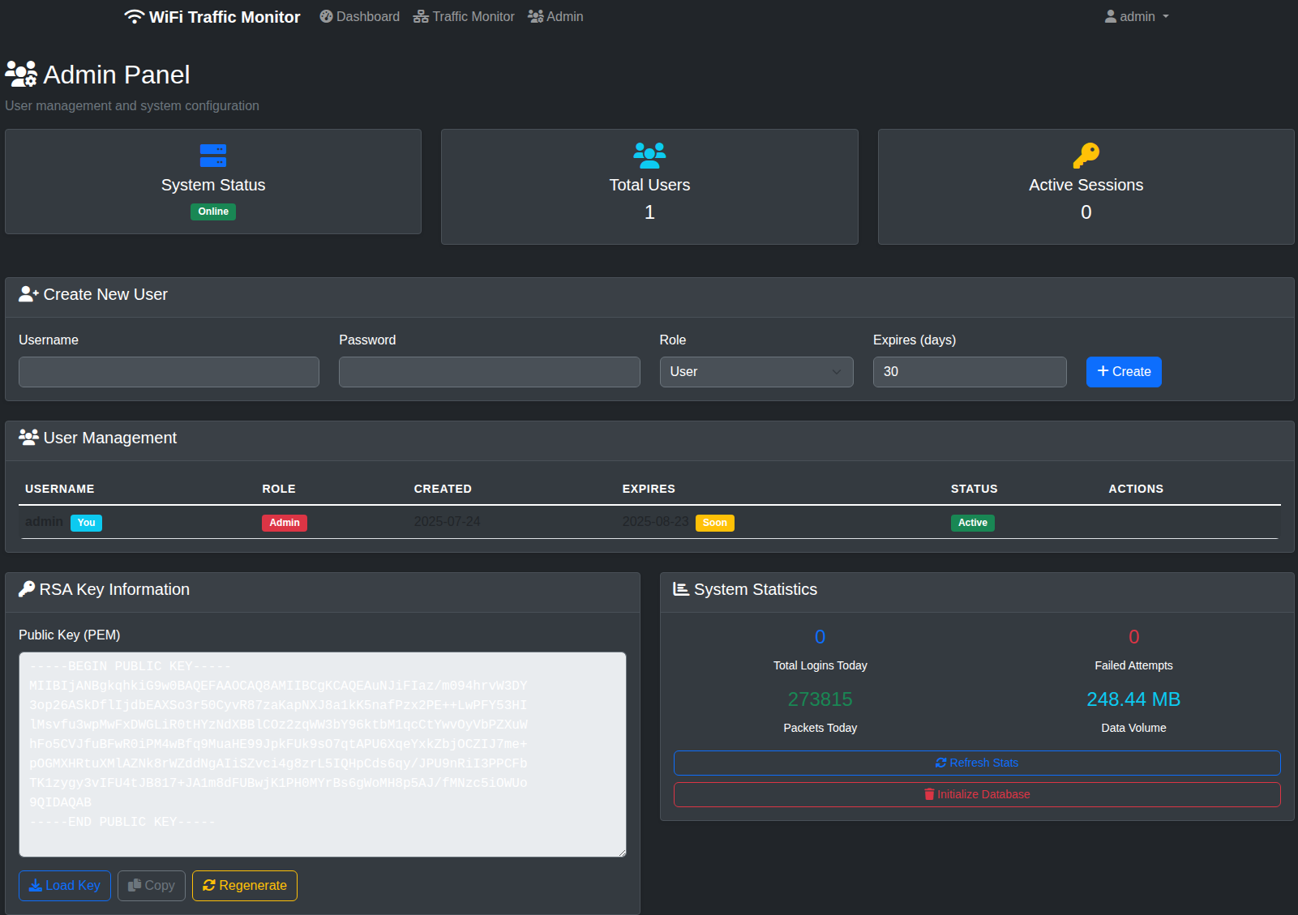
Admin Panel – System & User Management
The Admin Panel is the central hub for system configuration and security, separate from the traffic analysis dashboard.

Slide 37
Traffic Monitor: Deep Packet Inspection
Create New User:
Allows the administrator to create new user accounts.
You can define a Username, Password, assign a Role and set an expiration date for the account.
User Management Table:
Provides a comprehensive list of all existing users.

Slide 38
Traffic Monitor: Deep Packet Inspection
RSA Key Information:
Manages the public key for secure communication.
This is an advanced security feature, likely used to secure API connections or ensure encrypted communication between monitoring components.
System Statistics:
Offer a high-level overview of the system’s health.
You can quickly see the online status and statistics of the system.
You can also initialize the database.

Slide 39
Advanced Suggestion
Intelligent Network Monitoring
Notes:
- First chapter we learned different components of network ( nut and bolt of network )
- Second chapter we covered Network Protocol
- Third chapter we will cover a very important layer in network ( Network Layer ) from SDN point of view

Slide 40
Future Enhancements: Intelligent Network Monitoring with AI & LLM
Our current system provides a robust foundation for advanced network analysis.
By integrating AI and Large Language Models (LLMs), we can unlock powerful new capabilities.
1. Intelligent Threat Detection
Anomaly Detection
Proactive Defense
2. Content-Based Filtering & Blocking
Harmful Website Detection
Time-Based Access Control
3. Predictive Network Management
Bandwidth Prediction
Automated Troubleshooting
4. Enhanced Network Insights & Reporting
User Behavior Analysis
Natural Language Reporting

Slide 41
Summary
Traditional Control plane – OSPF protocol
Problems with OSPF routing
SDN Control plane, and how it can solve these issues
SDN architecture: ONOS, ODL
Several use cases handled by SDN: routing, port fail our
Q&A
Question: Is Routing and Forwarding is everything in SDN controller, or is there something more ?
Answer: More management and middlebox functionalities with the help of NFV and SFC in SDN architecture (next chapter)

